Slide 1
BCSE307L – COMPILER DESIGN

Slide 2
Course Outcomes
Apply the skills on devising, selecting, and using tools and techniques towards compiler design
Develop language specifications using context free grammars (CFG).
Apply the ideas, the techniques, and the knowledge acquired for the purpose of developing software systems.
Constructing symbol tables and generating intermediate code.
Obtain insights on compiler optimization and code generation

Slide 3
Syllabus
Module: 1 Introduction to Compilation and Lexical Analysis 7 hours
Introduction to LLVM - Structure and Phases of a Compiler-Design Issues-Patterns Lexemes-Tokens-Attributes-Specification of Tokens-Extended Regular Expression- Regular expression to Deterministic Finite Automata (Direct method) - Lex - A Lexical Analyzer Generator
Module: 2 Syntax Analysis 8 hours
Role of Parser- Parse Tree - Elimination of Ambiguity – Top Down Parsing – Recursive Descent Parsing - LL (1) Grammars – Shift Reduce Parsers- Operator Precedence Parsing - LR Parsers, Construction of SLR Parser Tables and Parsing- CLR Parsing- LALR Parsing
Module: 3 Semantic Analysis 5 hours
Syntax Directed Definition – Evaluation Order - Applications of Syntax Directed Translation - Syntax Directed Translation Schemes - Implementation of L-attributed Syntax Directed Definition
Module: 4 Intermediate Code Generation 5 hours
Variants of Syntax trees - Three Address Code- Types – Declarations - Procedures - Assignment Statements - Translation of Expressions - Control Flow - Back Patching- Switch Case Statements.

Slide 4
Cont..
Module: 5 Code Optimization 6 hours
Loop optimizations- Principal Sources of Optimization -Introduction to Data Flow Analysis - Basic Blocks - Optimization of Basic Blocks - Peephole Optimization- The DAG Representation of Basic Blocks -Loops in Flow Graphs - Machine Independent Optimization Implementation of a naïve code generator for a virtual Machine- Security checking of virtual machine code
Module: 6 Code Generation 5 hours
Issues in the design of a code generator- Target Machine- Next-Use Information – Register Allocation and Assignment- Runtime Organization- Activation Records.
Module: 7 Parallelism 7 hours
Parallelization- Automatic Parallelization- Optimizations for Cache Locality and Vectorization- Domain Specific Languages-Compilation- Instruction Scheduling and Software Pipelining- Impact of Language Design and Architecture Evolution on Compilers Static Single Assignment
Module: 8 Contemporary Issues 2 hours

Slide 5
Conversion from regular expression to DFA

Slide 6
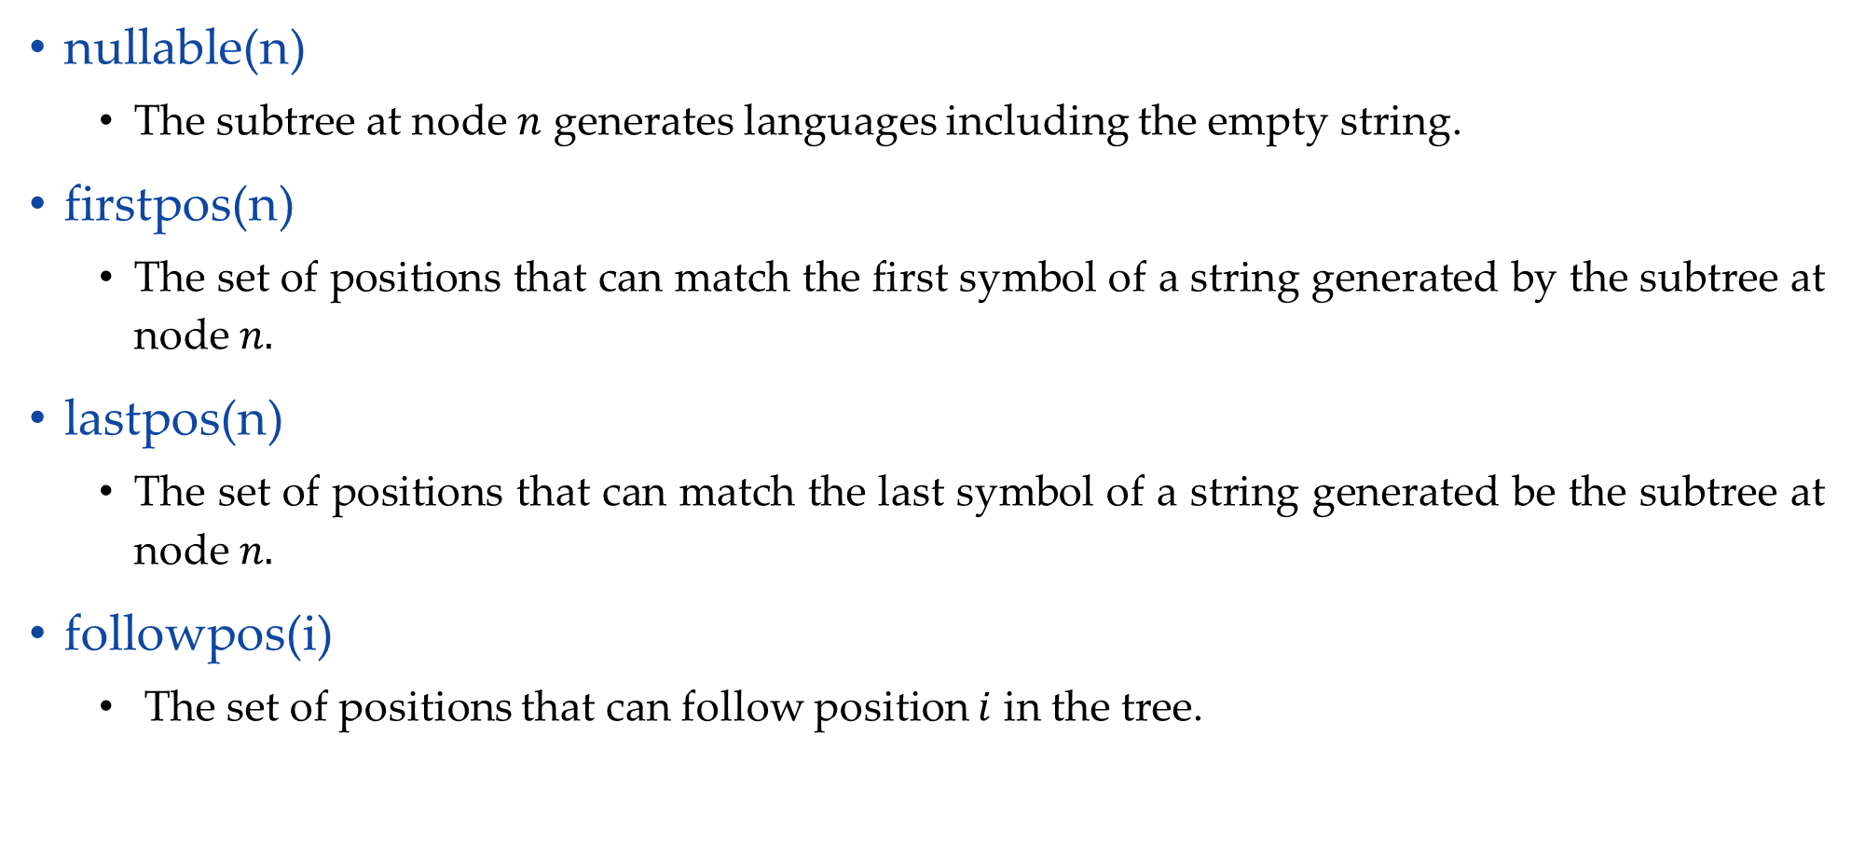
Rules to compute nullable, firstpos, lastpos
nullable(n)
The subtree at node $n$ generates languages including the empty string.
firstpos(n)
The set of positions that can match the first symbol of a string generated by the subtree at node $n.$
lastpos(n)
The set of positions that can match the last symbol of a string generated be the subtree at node $n.$
followpos(i)
The set of positions that can follow position $i$ in the tree.

Slide 7



Rules to compute nullable, firstpos, lastpos
Node n | nullable(n) | firstpos(n) | lastpos(n)
A leaf labeled by $$ | true | $$∅$$ | $$∅$$
A leaf with position $i$ | false | $$\{i\}$$ | $$\{i\}$$
 | nullable(c₁) or nullable(c₂) | firstpos(c₁) ∪ firstpos(c₂) | lastpos(c₁) ∪ lastpos(c₂)
n
$$|$$
c₁
c₂
 | nullable(c₁) and nullable(c₂) | if (nullable(c₁)) then firstpos(c₁) ∪ firstpos(c₂) else firstpos(c₁) | if (nullable(c₂)) then lastpos(c₁) ∪ lastpos(c₂) else lastpos(c₂)
n
$$.$$
c₁
c₂
 | true | firstpos(c₁) | lastpos(c₁)
n
$$∗$$
c₁

Slide 8
Rules to compute followpos
If n is concatenation node with left child c1 and right child c2 and i is a position in lastpos(c1), then all position in firstpos(c2) are in followpos(i)
If n is * node and i is position in lastpos(n), then all position in firstpos(n) are in followpos(i)

Slide 9














Conversion from regular expression to DFA
(a|b)
abb
Step 1: Construct Syntax Tree
*
#
.
Step 2: Nullable node
Here, * is only nullable node
.
$$\#$$
.
$$6$$
$$b$$
.
$$5$$
$$b$$
$$4$$
$$∗$$
$$a$$
$$3$$
$$|$$
$$a$$
$$b$$
$$1$$
$$2$$

Slide 10
















Conversion from regular expression to DFA
Step 3: Calculate firstpos
Firstpos
$$\{1,2,3\}$$
.
$$\{1,2,3\}$$
.
A leaf with position $i=\{i\}$
$$\{6\}$$
$$\#$$
$$\{1,2,3\}$$
.
$$6$$
$$\{5\}$$
$$b$$
n
$$|$$
$$\{1,2,3\}$$
.
$$5$$
firstpos(c₁) ∪ firstpos(c₂)
$$\{4\}$$
$$b$$
$$4$$
c₁
c₂
$$\{1,2\}$$
$$∗$$
$$\{3\}$$
$$a$$
$$∗$$
n
$$3$$
firstpos(c₁)
$$|$$
c₁
$$\{1,2\}$$
n
if (nullable(c₁))
thenfirstpos(c₁) ∪ firstpos(c₂) else firstpos(c₁)
$$.$$
$$a$$
$$b$$
$$\{1\}$$
$$1$$
$$\{2\}$$
$$2$$
c₁
c₂

Slide 11






















Conversion from regular expression to DFA
Step 3: Calculate lastpos
Lastpos
$$\{1,2,3\}$$
.
$$\{6\}$$
$$\{1,2,3\}$$
.
$$\{5\}$$
$$\{6\}$$
$$\{6\}$$
A leaf with position $i=\{i\}$
$$\#$$
$$\{1,2,3\}$$
.
$$6$$
$$\{4\}$$
$$\{5\}$$
$$\{5\}$$
n
$$b$$
$$|$$
$$\{1,2,3\}$$
.
$$\{3\}$$
$$5$$
lastpos(c₁) ∪ lastpos(c₂)
$$\{4\}$$
$$b$$
$$\{4\}$$
c₁
c₂
$$4$$
$$\{1,2\}$$
$$∗$$
$$\{1,2\}$$
$$\{3\}$$
$$a$$
$$\{3\}$$
n
$$∗$$
$$3$$
lastpos(c₁)
$$|$$
c₁
$$\{1,2\}$$
$$\{1,2\}$$
n
$$.$$
if (nullable(c₂)) then lastpos(c₁) ∪ lastpos(c₂) else lastpos(c₂)
$$a$$
$$b$$
$$\{1\}$$
$$\{1\}$$
$$\{2\}$$
$$\{2\}$$
c₁
$$1$$
$$2$$
c₂

Slide 12





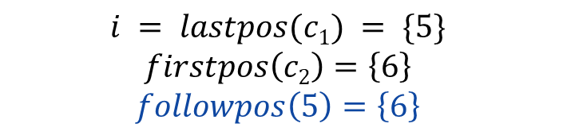

Conversion from regular expression to DFA
Step 4: Calculate followpos
Position | followpos
Firstpos
Lastpos
5 | 6
$$\{1,2,3\}$$
.
$$\{6\}$$
$$\{1,2,3\}$$
.
$$\{5\}$$
$$\{6\}$$
$$\{6\}$$
$$\#$$
$$\{1,2,3\}$$
.
$$6$$
$$\{4\}$$
$$\{5\}$$
$$\{5\}$$
$$b$$
$$\{1,2,3\}$$
.
$$\{3\}$$
$$5$$
.
$$\{4\}$$
$$b$$
$$\{4\}$$
$$4$$
$$\{1,2\}$$
$$∗$$
$$\{1,2\}$$
$$\{3\}$$
$$a$$
$$\{3\}$$
$$\{1,2,3\}$$
$$c1$$
$$\{5\}$$
$$\{6\}$$
$$c2$$
$$\{6\}$$
$$3$$
$$\{1,2\}$$
$$|$$
$$\{1,2\}$$
$$i = lastpos(c1) = \{5\}$$
$$firstpos\left(c2\right)=\left\{6\right\}$$
$$followpos\left(5\right)=\left\{6\right\}$$
$$a$$
$$b$$
$$\{1\}$$
$$\{1\}$$
$$\{2\}$$
$$\{2\}$$
$$1$$
$$2$$

Slide 13


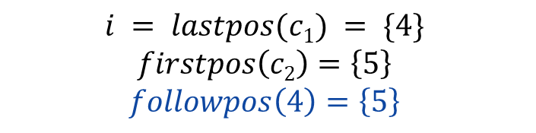

Conversion from regular expression to DFA
Step 4: Calculate followpos
Position | followpos
5 | 6
$$\{1,2,3\}$$
.
$$\{6\}$$
4 | 5
$$\{1,2,3\}$$
.
$$\{5\}$$
$$\{6\}$$
$$\{6\}$$
$$\#$$
$$\{1,2,3\}$$
.
$$6$$
$$\{4\}$$
$$\{5\}$$
$$\{5\}$$
$$b$$
$$\{1,2,3\}$$
.
$$\{3\}$$
$$5$$
.
$$\{4\}$$
$$b$$
$$\{4\}$$
$$4$$
$$\{1,2\}$$
$$∗$$
$$\{1,2\}$$
$$\{3\}$$
$$a$$
$$\{3\}$$
$$\{1,2,3\}$$
$$c1$$
$$\{4\}$$
$$\{5\}$$
$$c2$$
$$\{5\}$$
$$3$$
$$\{1,2\}$$
$$|$$
$$\{1,2\}$$
$$i = lastpos(c1) = \{4\}$$
$$firstpos\left(c2\right)=\left\{5\right\}$$
$$followpos\left(4\right)=\left\{5\right\}$$
$$a$$
$$b$$
$$\{1\}$$
$$\{1\}$$
$$\{2\}$$
$$\{2\}$$
$$1$$
$$2$$

Slide 14




Conversion from regular expression to DFA
Step 4: Calculate followpos
Position | followpos
Firstpos
Lastpos
5 | 6
$$\{1,2,3\}$$
.
$$\{6\}$$
4 | 5
$$\{1,2,3\}$$
.
$$\{5\}$$
3 | 4
$$\{6\}$$
$$\{6\}$$
$$\#$$
$$\{1,2,3\}$$
.
$$6$$
$$\{4\}$$
$$\{5\}$$
$$\{5\}$$
$$b$$
$$\{1,2,3\}$$
.
$$\{3\}$$
$$5$$
.
$$\{4\}$$
$$b$$
$$\{4\}$$
$$4$$
$$\{1,2\}$$
$$∗$$
$$\{1,2\}$$
$$\{3\}$$
$$a$$
$$\{3\}$$
$$\{1,2,3\}$$
$$c1$$
$$\{3\}$$
$$\{4\}$$
$$c2$$
$$\{4\}$$
$$3$$
$$\{1,2\}$$
$$|$$
$$\{1,2\}$$
$$i = lastpos(c1) = \{3\}$$
$$firstpos\left(c2\right)=\left\{4\right\}$$
$$followpos\left(3\right)=\left\{4\right\}$$
$$a$$
$$b$$
$$\{1\}$$
$$\{1\}$$
$$\{2\}$$
$$\{2\}$$
$$1$$
$$2$$

Slide 15





Conversion from regular expression to DFA
Step 4: Calculate followpos
Position | followpos
Firstpos
Lastpos
5 | 6
$$\{1,2,3\}$$
.
$$\{6\}$$
4 | 5
$$\{1,2,3\}$$
.
$$\{5\}$$
3 | 4
$$\{6\}$$
$$\{6\}$$
$$\#$$
.
$$6$$
2 | 3
$$\{1,2,3\}$$
$$\{4\}$$
$$\{5\}$$
$$\{5\}$$
$$b$$
1 | 3
$$\{1,2,3\}$$
.
$$\{3\}$$
$$5$$
.
$$\{4\}$$
$$b$$
$$\{4\}$$
$$4$$
$$\{1,2\}$$
$$∗$$
$$\{1,2\}$$
$$\{3\}$$
$$a$$
$$\{3\}$$
$$\{1,2\}$$
$$c1$$
$$\{1,2\}$$
$$\{3\}$$
$$c2$$
$$\{3\}$$
$$3$$
$$\{1,2\}$$
$$|$$
$$\{1,2\}$$
$$i = lastpos(c1) = \{1,2\}$$
$$firstpos\left(c2\right)=\left\{3\right\}$$
$$followpos\left(1\right)=\left\{3\right\}$$
$$followpos\left(2\right)=\left\{3\right\}$$
$$a$$
$$b$$
$$\{1\}$$
$$\{1\}$$
$$\{2\}$$
$$\{2\}$$
$$1$$
$$2$$

Slide 16




Conversion from regular expression to DFA
Step 4: Calculate followpos
Position | followpos
Firstpos
Lastpos
5 | 6
$$\{1,2,3\}$$
.
$$\{6\}$$
4 | 5
$$\{1,2,3\}$$
.
$$\{5\}$$
3 | 4
$$\{6\}$$
$$\{6\}$$
$$\#$$
2 | 3
.
$$6$$
1,2,
$$\{1,2,3\}$$
$$\{4\}$$
$$\{5\}$$
$$\{5\}$$
$$b$$
1 | 3
1,2,
$$\{1,2,3\}$$
.
$$\{3\}$$
$$5$$
$$\{4\}$$
$$b$$
$$\{4\}$$
$$4$$
$$\{1,2\}$$
*
$$\{1,2\}$$
$$\{1,2\}$$
$$∗$$
$$\{1,2\}$$
$$\{3\}$$
$$a$$
$$\{3\}$$
$$n$$
$$3$$
$$\{1,2\}$$
$$|$$
$$\{1,2\}$$
$$i = lastpos(n) = \{1,2\}$$
$$firstpos\left(n\right)=\left\{1,2\right\}$$
$$followpos\left(1\right)=\left\{1,2\right\}$$
$$followpos\left(2\right)=\left\{1,2\right\}$$
$$a$$
$$b$$
$$\{1\}$$
$$\{1\}$$
$$\{2\}$$
$$\{2\}$$
$$1$$
$$2$$

Slide 17
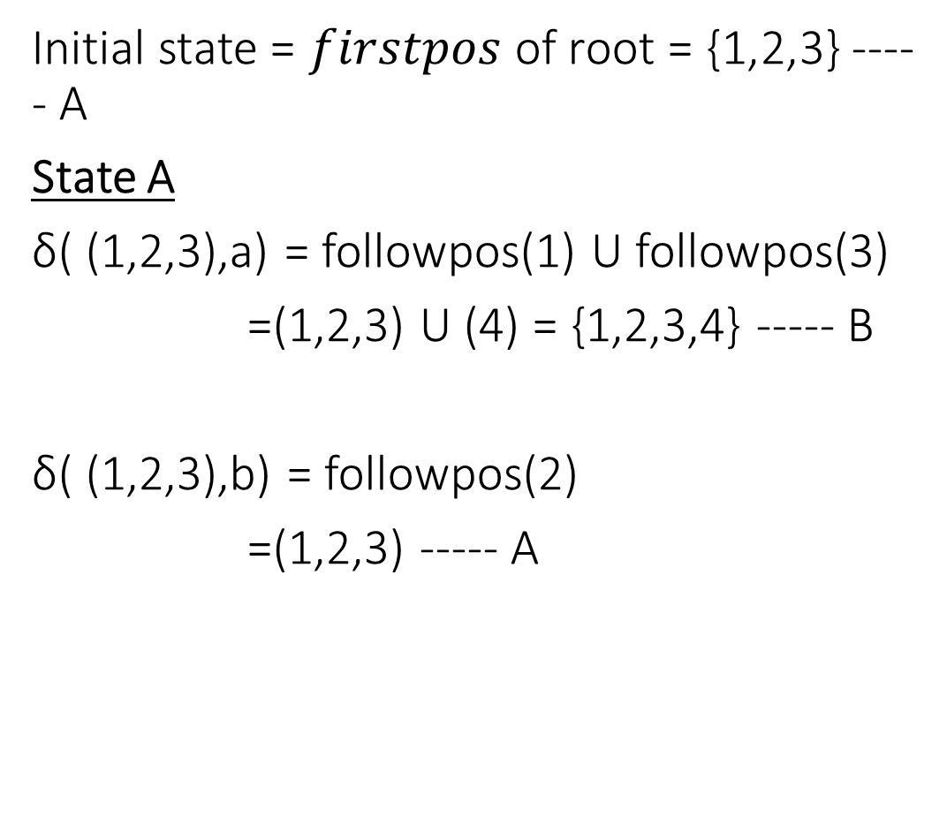
Conversion from regular expression to DFA
Initial state = $firstpos$ of root = {1,2,3} ----- A
State A
δ( (1,2,3),a) = followpos(1) U followpos(3)
=(1,2,3) U (4) = {1,2,3,4} ----- B
δ( (1,2,3),b) = followpos(2)
=(1,2,3) ----- A
Position | followpos
5 | 6
4 | 5
3 | 4
2 | 1,2,3
1 | 1,2,3
States | a | b
A={1,2,3} | B | A
B={1,2,3,4}

Slide 18
Conversion from regular expression to DFA
State B
δ( (1,2,3,4),a) = followpos(1) U followpos(3)
=(1,2,3) U (4) = {1,2,3,4} ----- B
δ( (1,2,3,4),b) = followpos(2) U followpos(4)
=(1,2,3) U (5) = {1,2,3,5} ----- C
State C
δ( (1,2,3,5),a) = followpos(1) U followpos(3)
=(1,2,3) U (4) = {1,2,3,4} ----- B
δ( (1,2,3,5),b) = followpos(2) U followpos(5)
=(1,2,3) U (6) = {1,2,3,6} ----- D
Position | followpos
5 | 6
4 | 5
3 | 4
2 | 1,2,3
1 | 1,2,3
States | a | b
A={1,2,3} | B | A
B={1,2,3,4} | B | C
C={1,2,3,5} | B | D
D={1,2,3,6}

Slide 19
Conversion from regular expression to DFA
State D
δ( (1,2,3,6),a) = followpos(1) U followpos(3)
=(1,2,3) U (4) = {1,2,3,4} ----- B
δ( (1,2,3,6),b) = followpos(2)
=(1,2,3) ----- A
Position | followpos
5 | 6
4 | 5
3 | 4
2 | 1,2,3
1 | 1,2,3
b
States | a | b
a
A={1,2,3} | B | A
A
a
B
b
C
b
D
B={1,2,3,4} | B | C
C={1,2,3,5} | B | D
a
a
D={1,2,3,6} | B | A
b
DFA

Slide 20
Example 2
Convert the following RE to DFA (Direct Method):
ba(a+b)*ab

Slide 22
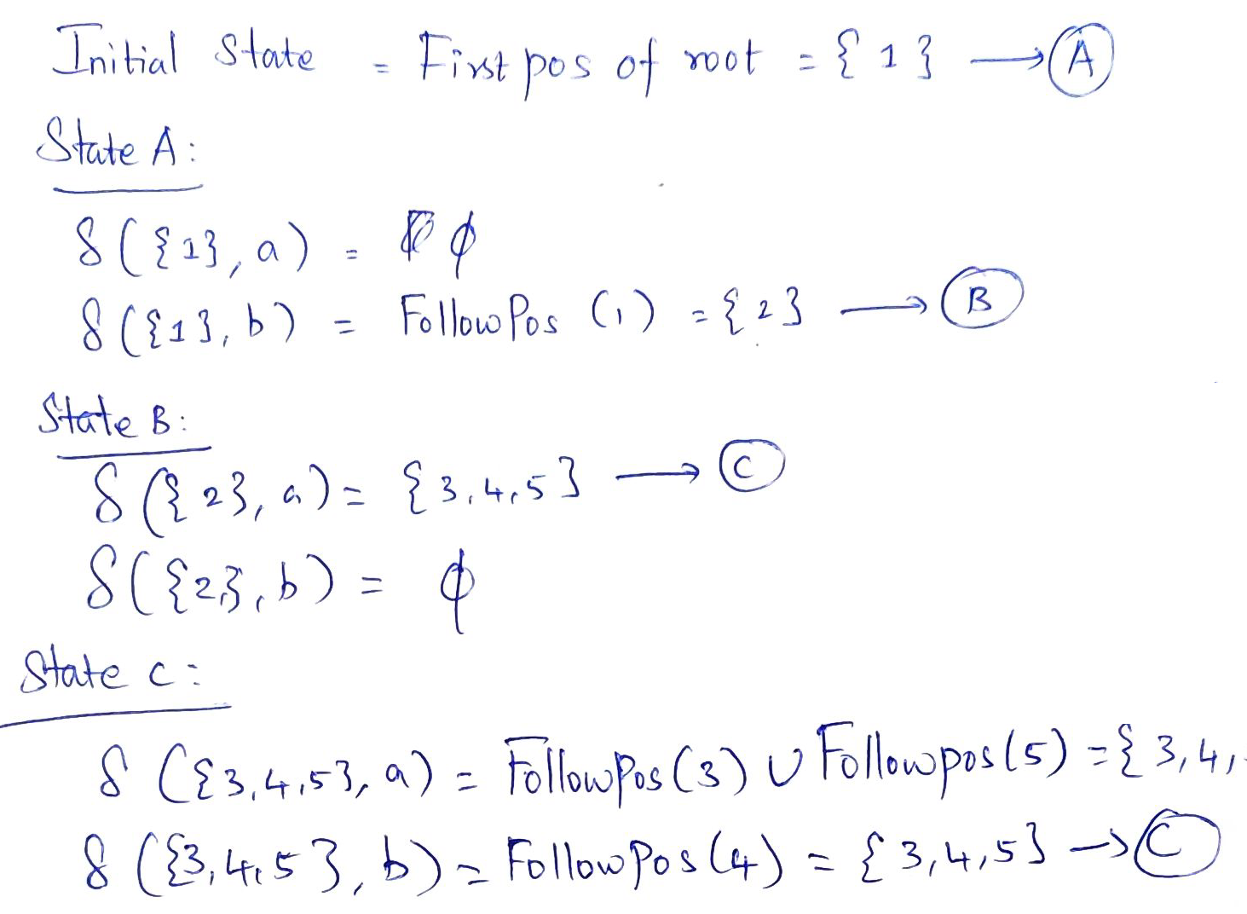

Slide 25
Practice Problems
Convert the following regular expressions to deterministic finite automata:
(a|b)*
(a*|b*)*
((ε|a)|b*)*
(a|b)*abb(a|b)*

Slide 26
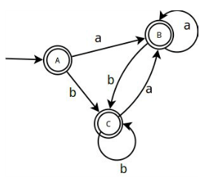
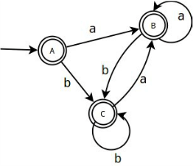
Solutions to practice problems
(a*|b*)*
(a|b)*

Slide 27
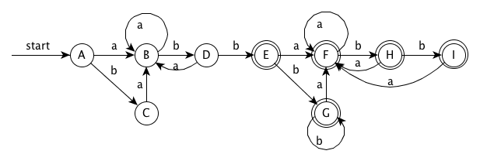

Slide 28
Conversion from regular expression to DFA
Construct DFA for following regular expression:
(c | d)*c
(a+b)*+(a.c)*

